Slide 1
Group 8
Speech-to-text Resume Builder
(https://github.com/eurashin/CS498-Group8.git)

Slide 2
Inspiration for this project
The need of a good resume is unquestionable.
Though you may have good credentials, if you are not able to portray them well, then you may not get the best out of them. And many individuals face this issue.
Therefore, we planned on building a platform for people to format their resume by just talking about themselves.

Slide 3
Brief info about the project
Speech-to-text is the main component.
So, talk about yourself, get better at it; and also build yourself a Resume.
Webapp that’s open for all to use.
Get multiple types of Resumes to choose from.
Languages used – JavaScript, Python, HTML & CSS

Slide 4
Key points about the project
It takes away the need for an individual to keep himself/herself aware about the format of a resume.
It can be used for a broad range of applications such as Medical, Computer Science and Business Style Resumes.
The more you talk about yourself and your achievements, in brief; the better you get at pitching yourself to the companies.
If any false inputs are recorded, the first draft of Resume is an editable file. Then once all is saved, it can be saved as pdf.; as a final draft.

Slide 5
Brief overview of how it works:
Choose a resume template/theme
Complete an interview
Fill and edit resume as a form
Download resume for printing!

Slide 6
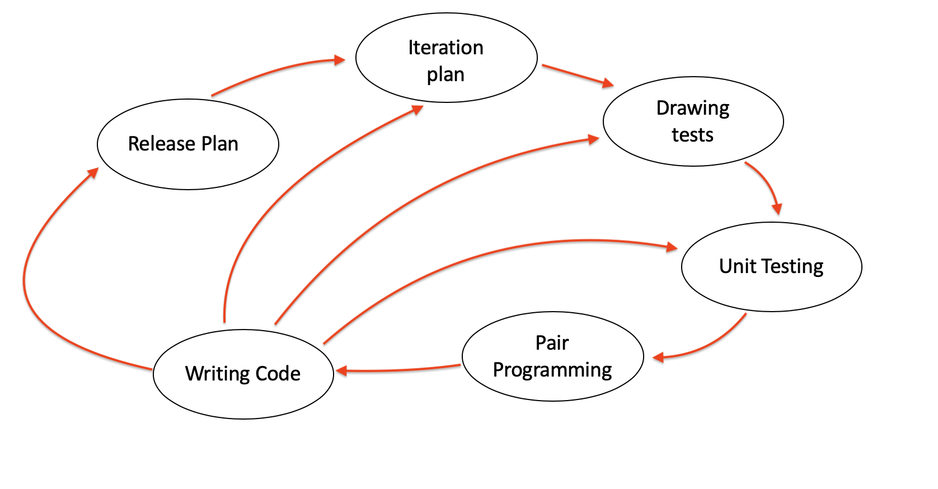
How we used Extreme Programming

Slide 7
Development with each iteration
Iteration 1 – Get the Speech to Text ready with Google APIs. The bot will ask users questions and record the answers.
Iteration 2 – Get the basic webapp ready.
Iteration 3 – Get the speech to text working on the webapp and add the extra resume options.

Slide 8
CFG and Tests

Slide 9
Future use and development options of this project
Add user accounts to keep a track of past resumes.
Add more resume options to cater larger audience.

Slide 10
Thank You !

